Slide 1





Employee Attrition and Risk Prediction Analysis
Created by Michael Michie

Slide 2
Dataset Overview
Total employees in dataset: 1,470, with 237 recorded departures — representing a 16.1% overall attrition rate.
Class imbalance is significant: 83.9% of employees stayed while only 16.1% left, posing a challenge for predictive modeling.

Slide 3
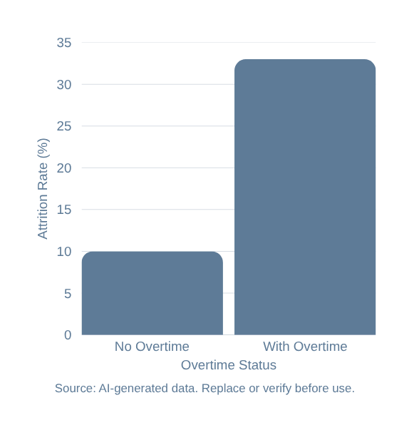
Overtime and Attrition Pattern
Overtime is the strongest single predictor of attrition. Employees working overtime leave at roughly 3× the rate of those without it:
• No overtime (~1,060 employees): ~10% attrition
• With overtime (~420 employees): ~33% attrition
Addressing overtime burden may be the highest-leverage lever for reducing employee departures.

Slide 4
Income, Tenure & Age
Monthly income: leavers median ~$3,200 vs. stayers ~$5,200 — leavers concentrated in lower income bands, suggesting compensation is a key attrition driver.
Tenure & Age: leavers median ~3 years vs. stayers ~6 years; attrition is highest in the 18–34 age range and declines sharply after age 40, indicating early-career employees are at greatest risk.

Slide 5








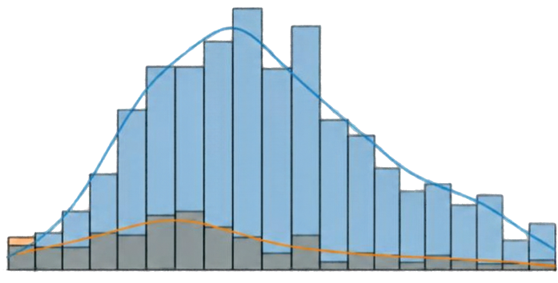









Age Distribution
The chart breaks down employees by age and shows how many left (attrition) vs. stayed.
Age Distribution by Attrition
Key Pattern
Attrition
Attrition is concentrated among younger employees, especially ages 18–34.
The share of employees who leave declines sharply after age 40.
0 (Stayed)
1 (Left)
Number of Employees
Income (Monthly Median)
Employees who leave earn less.
-$3,200 (leavers) vs. ~$5,200 (stayers)
20
30
40
50
60
Age
Tenure (Median)
Most attrition happens at younger ages, especially 18–34.
Employees who leave have shorter tenure.
~3 years (leavers) vs. ~6 years (stayers)
After age 40, the share of employees who leave drops sharply.
Takeaway (Association, Not Causation)
Younger employees with lower income and shorter tenure are more likely to leave.
These factors are associated with attrition but do not prove they cause it.

Slide 6
Baseline Model Performance
Logistic Regression
Random Forest
  Caught about half of the people who actually left
  When it predicted someone would leave, it was right about half the time
  Correct on 86 out of 100 predictions overall, but that number looks better than it is, because always guessing “stay” would score high too
  Overall balance score: 0.49 out of 1.0
  Caught only 13 out of 100 people who actually left, which is very low
  When it did predict “leave,” it was often right, but it rarely made that prediction, so the result is misleading
  Correct on 84 out of 100 predictions overall, but nearly all of those were “stay” guesses
  Overall balance score: lower than Logistic Regression

Slide 7
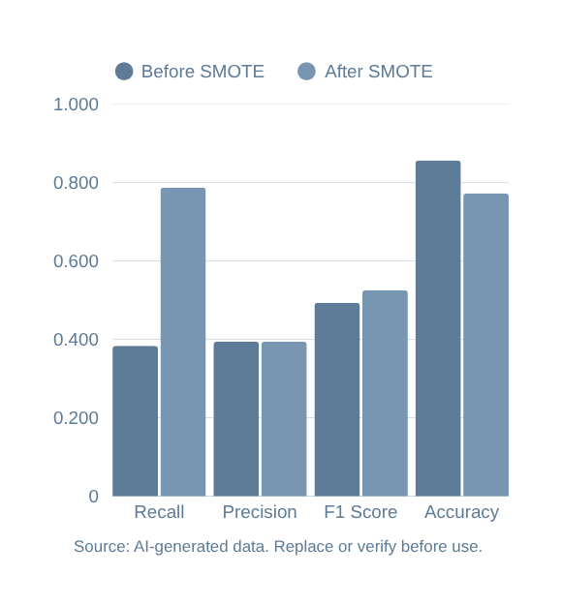
SMOTE Results
What improved
  The model now caught about 79 out of 100 people who actually left, up from 38 out of 100 before. That is roughly double.
  Overall balance score rose slightly, from 0.49 to 0.53 out of 1.0
What got worse (the trade-offs)
  When the model predicted someone would leave, it was right only about 39% of the time, so it raises more false alarms
  Overall correct predictions dropped from 86 out of 100 to 77 out of 100, because the model is no longer defaulting to “stay”
Takeaway: SMOTE made the model much better at spotting people likely to leave, at the cost of more false alarms. For a project about reducing turnover, catching more real cases is usually worth some extra false alarms.

Slide 8
Cross-Validation & Tuning
  ROC-AUC: A score where 0.5 means guessing and 1.0 means perfect.
  Runtime errors: Be upfront: “We couldn’t complete the final test for the tuned Random Forest, but its cross-validation results already showed it trailing.”
  Different F1 numbers: This slide shows 0.441 and the baseline slide showed 0.493 because cross-validation averages several splits. Be ready to explain that.
  Tuning settings: Left out on purpose. Put them in speaker notes or an appendix.
  Shorter slide: “Repeated testing confirmed the simple model (Logistic Regression) is more reliable than the tuned complex model (Random Forest).”

Slide 9
Limitations and Future work
  There are no leave dates or time dimension, so the model can say who is at risk but not when they might leave. It also doesn’t separate voluntary from involuntary exits.
  Overtime is the strongest link to attrition (about +0.25 correlation), but the data can’t show that reducing overtime would reduce attrition.
  It leaves out external factors. Manager quality, the job market and pay relative to competitors aren’t recorded.
  Fairness audit: comparing error rates across gender, age and marital status, to determine finer details into their reasoning.
  Pay-gap feature: dropping JobLevel from the income model and use the gap between actual and predicted pay as a new attrition predictor.
  Real-world validation: test on real company data, then pilot retention actions and measure whether they lower attrition.

Slide 10
Thank you
Q&A

